Slide 1

DATA ENGINEER
Learning Progress Review 6th Week

Slide 2
We are Gold D. S.
Rinaldy Widyantoro
Rian Pauzi
Hanief Fatchudin

Slide 3
ADVANCED SQL: IMPROVING SQL PERFORMANCE

Slide 4
HOW TO MAKE READABLE QUERY?
QUERY WRITING SUGGESTION
Consistency
Uppercase for SQL Syntax
Make new line for every (SELECT, FROM, WHERE)
Add indentation for everty (Sub Query, ON, AN/OR)
Add semicolon to end the statement
Make an alias for long query
Adding comment if necessary

Slide 5
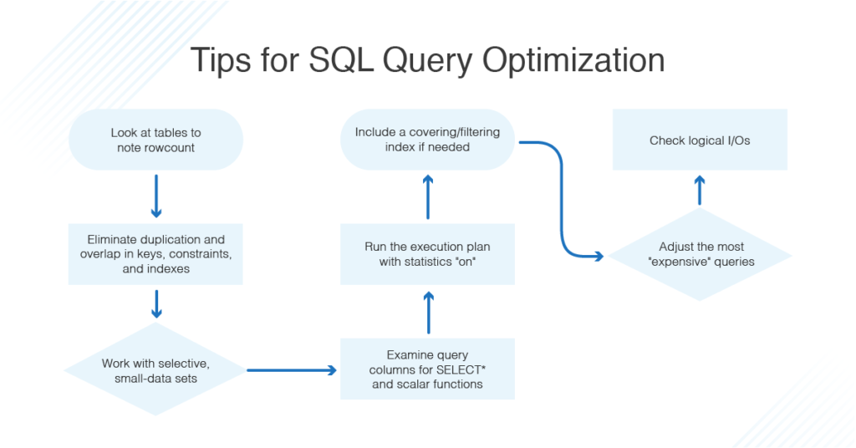
HOW TO DECIDE WHICH SYNTAX TO BE IMPROVED?
Syntax Order
Processing Order
Logical Processing Order

Slide 6
HOW TO FILTER DATA
WHERE
We using WHERE we want to filter in and/or filter out the result FROM statement
WHERE statement will be checked on every row
WHERE statement will be processed first before SELECT statement
There will be no difference on the small set of data but will be matters on huge data
HAVING
HAVING statement working similarly like WHERE statement except HAVING will be FILTER OUT data that already being grouped.
Only can be used to filter Numeric type of Data

Slide 7
HOW TO EXTRACT DATA EFFICIENTLY?
Process after SELECT statement
Need a huge resource to run after this (expensive)
Only use with caution
USING SELECT
Only pick the column that you really need
Forget it if not necessary
USING LIMIT
Limit will be limiting the result of the statement
Will be executed on the very last
USING ORDER BY
Will ordering the result (can be ascending or descending)
Dont use it if not necessary because take lots of resource

Slide 8
HOW TO MANAGE DUPLICATION?
Duplications happened due to bad design of data or wrong query statement to get the data
To avoid that you can use:
DISTINCT
Can be used to remove duplicate or make unique result
Use with caution due to large resource can be taken
UNION OR UNION ALL
Merging two set different tables with the same column name
UNION will merge data and will remove duplicate data eep all
UNION ALL will merge data as it is

Slide 9
HOW TO SPEED UP SEARCHING?
Using index: index is a structure that can be used to speed up the query result. it works is like a postman sending mail to the receiver, the postman already know the address, so they doesn’t need to knock every doors one by one. Just knock the recipient doors
Type of INDEX:
CLUSTERED
Like a dictionary, every rows already ordered by the value
NON CLUSTERED
Like a glossary, have a layered page that mapped into unordered row
Process insert and update can be faster than clustered

Slide 10


No SQL (MongoDB)

Slide 11
WHAT IS MongoDB ?
MongoDB is an open source NoSQL database management program. NoSQL is used as an alternative to traditional relational databases. NoSQL databases are quite useful for working with large sets of distributed data. MongoDB is a tool that can manage document-oriented information, store or retrieve information.

Slide 12
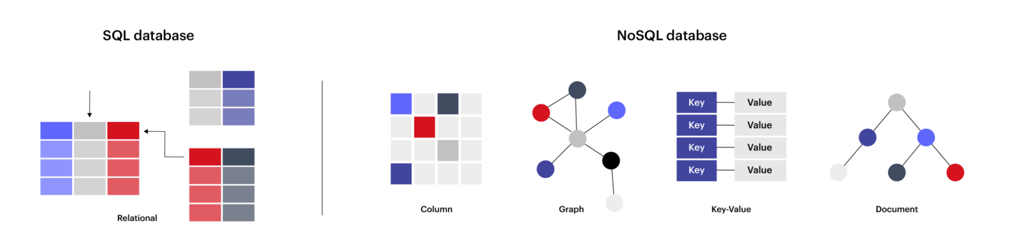
SQL DATABASE VS NoSQL DATABASE
Relational Data Model
Pros
Easy to use and setup
Universal, compatible with many tools
Good at high-performance workloads
Good at structure data
Cons
Time consuming to understand and design the structure of the database
Can be difficult to scale
Document Data Model
Pros
No Investment to design model
Rapid development cycles
In general faster than SQL
Runs well on the cloud
Cons
Unsuited for interconnected data
Technology still maturing
Can have slower respone time

Slide 13
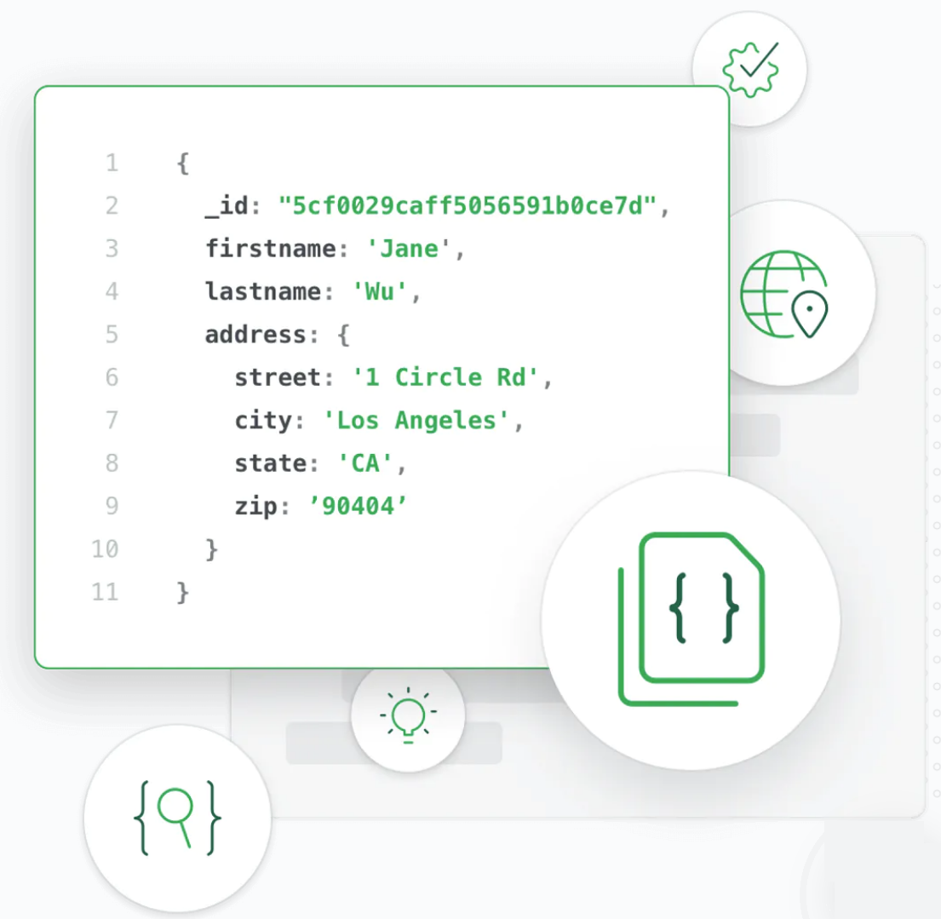
NoSQL MongoDB
MongoDB stores data in flexible, JSON-like documents, meaning fields can vary from document to document and data structure can be changed over time
The document model maps to the objects in your application code, making data easy to work with
Ad hoc queries, indexing, and real time aggregation provide powerful ways to access and analyze your data
MongoDB is a distributed database at its core, so high availability, horizontal scaling, and geographic distribution are built in and easy to use

Slide 14
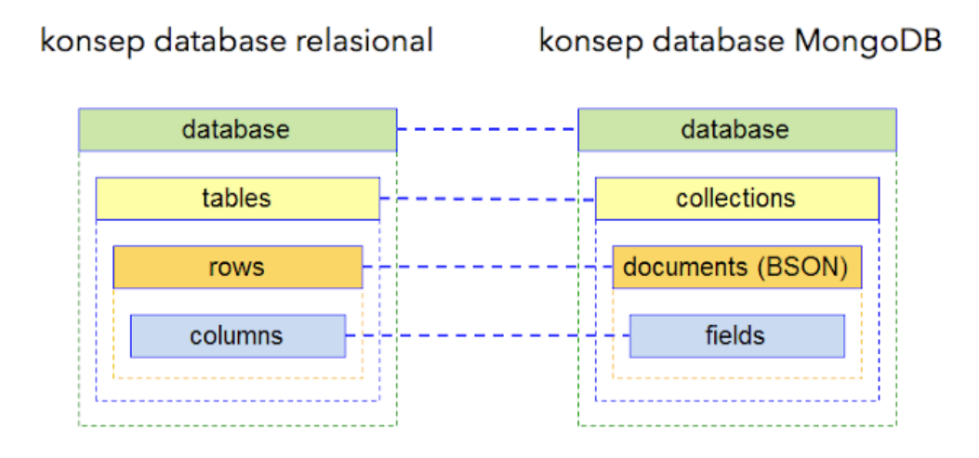
SQL VS MongoDB
Database: is the element at the top level. In a relational database, a database generally consists of tables and views. In MongoDB, a database is a physical container that contains a structure called a collection. Each database has its own set of files in the storage media filesystem. Generally, a single MongoDB server consists of a number of databases.
Collection: is a group of MongoDB documents. Collections can be matched with tables in an RDBMS. Multiple collections can exist in the same database but must have different names.
Documents: is the smallest unit of data in MongoDB. Basically composed of a group of key-value pairs. Unlike records in an RDBMS, documents have a dynamic schema, meaning that documents that are in a collection do not have to have the same set of fields.

Slide 15

MongoDB Atlas
MongoDB Atlas is a fully-managed cloud database developed by the same people that build MongoDB. Atlas handles all the complexity of deploying, managing, and healing your deployments on the cloud service provider of your choice (AWS, Azure, and GCP).
A replica set in MongoDB is a group of mongod processes that maintain the same data set connected from multiple machines. Replica sets provide redundancy and high availability, and are the basis for all production deployments. replica sets can ensure that if something happens to one of the machines, the data will remain intact.

Slide 16
Export and Import MongoDB
Export is the process of outputting data or copying data from a file stored in MongoDB collection to our computer, usually in the form of a .json file.
Import is the process of entering data or copying data from files stored on our computer into a MongoDB collection, usually in the form of a .json file.
Export data .JSON
Import data .JSON
mongoexport --uri=“<Atlas Cluster URI>"
--collection=<collection name>
--out=<filename>.json
mongoimport --uri=“<Atlas Cluster URI>"
--drop=<filename>.json

Slide 17
Collection Method
NAME | DESCRIPTION
db.collection.deleteOne() | Deletes a single document in a collection.
db.collection.deleteMany() | Deletes multiple documents in a collection.
db.collection.drop() | Removes the specified collection from the database.
db.collection.find() | Performs a query on a collection or a view and returns a cursor object.
db.collection.findOne() | Performs a query and returns a single document.
db.collection.updateOne() | Modifies a single document in a collection.
db.collection.updateMany() | Modifies multiple documents in a collection.

Slide 18
ETL FROM SCRATCH WITH PYTHON (SCRAPING)

Slide 19
EXTRACT
WE CAN CATEGORIZE ‘WEB SCRAPING’ AS ‘E’ (EXTRACT) PROCESS IN ETL
TECHNIC IN WEB SCRAPING:
COPY-PASTE
PATTERN MATCHING
HTML PARSING
ETC.
IN WEB SCRAPING, WE CAN USE ‘PANDAS’ FOR SPECIFIC READ_TABLE:
PANDAS.READ_HTML(“SOME_WEBSITES_URL”)

Slide 20
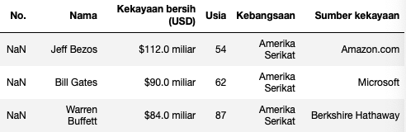
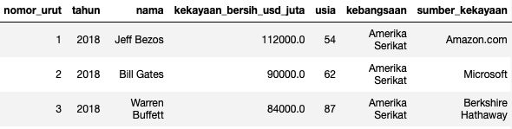
TRANSFORM
WE CAN CATEGORIZE ‘CLEANING DATA’ AS ‘T’ (TRANSFORM) PROCESS IN ETL
CLEANING DATA TO TRANSFORMATION DATA FROM ONE FORM TO ANOTHER
FOR EXAMPLE TRANSFORM VALUE COLUMN FROM STRING TO NUMERIC AND ADD COLUMN YEAR IN TABLE:
Before:
After Transform:

Slide 21
LOAD
WE CAN CATEGORIZE ‘STORING DATA TO DATABASE AS ‘L’ (LOAD) PROCESS IN ETL
PROCESS LOAD NOT ONLY STORING TO DATABASE, BUT ALSO TO FILE LIKE CSV, PARQUET, ORC, ETC.
METHOD TO STORING DATABASE USUALLY USING 2 TOOLS:
PANDAS
SQLALCHEMYS

